Slide 1



Challenges of Different types of Distributed file systems
Team : Pragathi Thammaneni
Sridevi Mallipudi

Slide 2
Agenda
Abstract
Introduction
Literature review
Comparative analysis
Recommendations
Conclusion

Slide 3
ABSTRACT :
Why DFS ?
Need for storing huge volumes of data for the massive internet applications.
DFS -Distributed File System
“ Distributed File System provides a centralized storage for data. As the amount of data storage is continuously increasing, the problem of providing efficient and fault tolerant solution arises and this problem is overcome with use of DFS “
Motivation & objective :
To analyze and interpret the current challenges related to design of DFS

Slide 4
Introduction :
Local file systems could not handle the immense amount of data
Distributed File System
DFS don’t directly process or compute the data but provides
An effective framework which allows clients or applications to store and share data
Collection of independent nodes that appears to provide centralized file system view.
Namespace - group of shared folders located at different locations are connected transparently by one or more

Slide 5
Architecture :
4 types of architectures in DFS
Client –Server Architecture
Cluster based DFS
Symmetric
Asymmetric

Slide 6
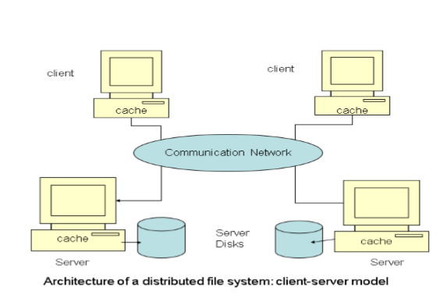
Architecture Cont. … :
Client –Server Architecture
This makes collection of processes running on different operating systems to share a common file system.
Client can access files on server

Slide 7
Architecture Cont. … :
Cluster based DFS
Single master server along with multiple chunk servers each divided into 64 MB
Example :Google File System
Important features are :
Decoupled metadata and data
Reliable Autonomic Distributed Object Storage
Dynamic Distributed Metadata Management.
Master server can control hundreds of chunk servers

Slide 8
Architecture Cont. … :
Symmetric Architecture
Based on peer –peer technology
Uses key based lookup mechanism combined with DHT based system for distributing data
Asymmetric Architecture
One or more dedicated managers are present to maintain the file system and its associated disk structure
Supports
Parallel node access of file at the same time
Concurrent read writes operations

Slide 9
Desirable Features of DFS :
Transparency
Users must be unaware of the location of services / transfer of data from remote location to local machine
Replication
For reliability, data is duplicated and copied to different nodes to protect against failures
Scalability
New nodes can be added to existing system for increasing the DFS capacity
Reliability
System is made available to client all the time by using connection-oriented protocols.

Slide 10
Desirable Features of DFS :
Fault Tolerance
DFS should respond appropriately in case of failure
Consistency
Different clients must see same file contents at same time
Security
Authentication and secure communication must be provided

Slide 11
LITERATURE REVIEW :
Lazy replication technique in HDFS
Evolution and analysis of Distributed File System in Cloud Storage
Load Balancing in distributed File System

Slide 12
Lazy replication technique in HDFS :
In HDFS, fault tolerance is handled by using data replication
Each block of data is copied and stored on multiple Data Nodes.
Existing implementation is performed in pipelined manner which consumes more time for replication
Lazy replication
Block of data from client is written to the first Data Node
Which will send the acknowledgements directly to client without waiting for receiving acknowledgement from other Data Nodes.

Slide 13
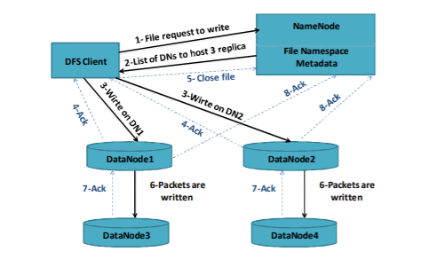

Lazy replication technique in HDFS CONT…:
Pros
Increased throughput and improved data availability
Cons
The drawback with this technique is efficient storage utilization

Slide 14
Evolution and analysis of Distributed File System in Cloud Storage
GFS and HDFS are scalable distributed file systems designed to handle large scales of data. But they are not considered suitable for
Handling files with small sizes
Frequently changing data
Low latency data access
Using HBase on the top of HDFS can solve the problem of low latency access to small files from the large data chunks.
Recommendations are proposed for future work to improve caching techniques and to reduce MetaData storage and low latency data access.

Slide 15
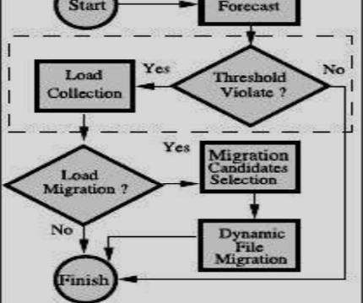
Load Balancing in distributed File System :
Performance of a DFS can be measured by Minimum response time
Can be improved with good design of load balance algorithm
Static and dynamic load balancing strategies
Self-acting, load balancing (SALB) for parallel file system
Adaptive loading data migration (ALDM) in distributed file system

Slide 16
Load Balancing in distributed File System :
SLAB Pros
Distributed load balancer helps to improve scalability of the system
SLAB Cons
Based on throughput of each node which may be weak in the case of Hotspot problem.
ALDM Pros
Every node sends load to a centralized node for centralized decision of load migration
ALDM Cons
Performance can be affected with failure in centralized node

Slide 17
Comparative Analysis :
Characteristics of different DFS
Architecture
Processes
Communication
Naming
Scalability
Synchronization
Consistency and Replication
Fault Tolerance
Security

Slide 18
Comparative Analysis Cont. …
Different DFS according to the requirements
Google File System (GFS)
Hadoop Distributed File System(HDFS)
Cassandra File System (CFS)
Network File System (NFS)
Andrew File System(AFS)
Lustre (Shared disk file system)
Panasas
Parllel Virtual File System (PVFS2)
Kosmos Distributed File System(KFS)
RGFS

Slide 19
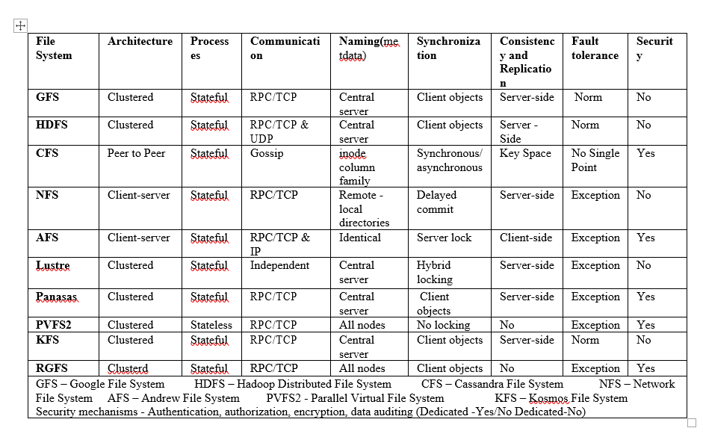
Comparative Analysis CoNT…

Slide 20
Recommendations :
Each of the distributed file systems has both advantages and disadvantages based on certain parameters.
The recommended file systems based on analysis with different parameters are
HDFS
GFS
Both are similar in many aspects But GFS provides better error monitoring, auto-recovery compared
PVFS2 has the poor performance

Slide 21
Conclusion :
DFS - widely used form for file sharing through which multiple users can store and share resources
The key issues that need to be taken into consideration while designing the DFS
Synchronization
Consistency
Replication
Fault tolerance
Security

Slide 22
References :
Akram Elomari, "The main characteristics of five distributed file systems required for big data: A comparative study", RITM-ESTC / CED-ENSEM, University Hassan II, ZIP Code 8012, Morocco,2017.
Dharavath Ramesh, “Evolution and Analysis of Distributed File Systems in Cloud Storage: Analytical Survey “, Department of Computer Science and Engineering Indian School of Mines, Dhanbad, India,2016.
Shyam C. Deshmukh, " A Survey: Load Balancing for Distributed File System," ME Computer SP Pune University PCCOE, Pune,2015.
L.Sudha Rani, “Distributed File Systems: A Survey”, Assistant Professor, Computer Science Department, GPREC, Kurnool, (IJCSIT) International Journal of Computer Science and Information Technologies, Vol. 5 (3) , 2014, 3716-3721
Yongwei Wu, " Modeling of Distributed File Systems for Practical Performance Analysis," 2014.

Slide 23
References CONT …. :
Tran Doan Thanh, “A Taxonomy and Survey on Distributed File Systems”, SK Telecom Convergence and Internet R&D Center / SK T-Tower, Seoul, Korea, 2010.
Yu, W., Liang, Sh., Panda, D.K., “High performance support of parallel virtual file system (PVFS2) over Quadrics”, Proceedings of the 19th annual international conference on Supercomputing, pp. 323-331, 2005
Ghemawat, S., Gobioff, H., Leung, S.T., “The Google file system”, ACM SIGOPS Operating Systems Review, Volume 37, Issue 5, pp. 29-43, December, 2003
Satyanarayanan, M., "A Survey of Distributed File Systems," Technical Report CMU-CS-89- 116, Department of Computer Science, Camegie Mellon University, 1989

Slide 24
Thank you…!!!

